Slide 1

WEATHER DATA ANALYSIS WITH PYTHON
An presentation to exploring and gaining insights from weather data using Python programming language.

Slide 2
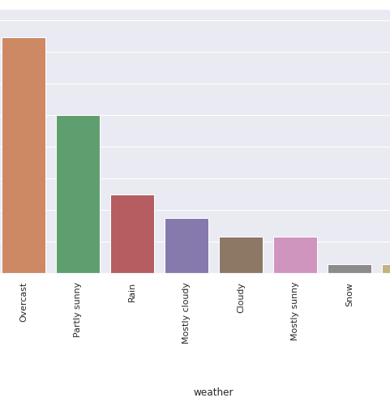
What is Weather Analysis?
The study of atmospheric conditions over a specific period to understand weather patterns and trends. It involves collecting, processing, and interpreting weather data.
WHY WEATHER DATA ANALYSIS?
Weather data analysis provides valuable insights that can significantly benefit various industries. By understanding weather patterns, trends, and anomalies, businesses can make more informed decisions, optimize operations, and mitigate risks. This information is crucial for industries such as agriculture, transportation, and energy, which are heavily influenced by weather conditions.

Slide 3
DATA SOURCES
National Oceanic and Atmospheric Administration (NOAA)
Weather Underground
OpenWeatherMap
Dark Sky API
Collected Data Sources: India Weather Data (source), BBSR Weather Data (source)

Slide 4
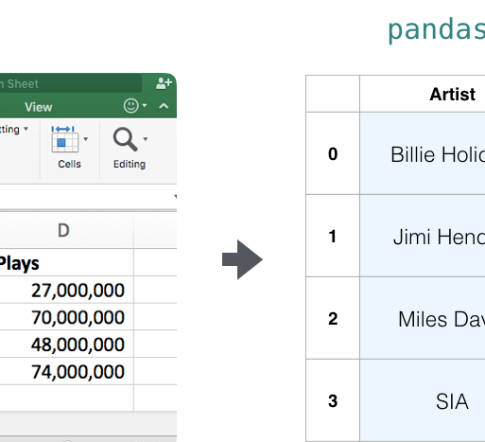
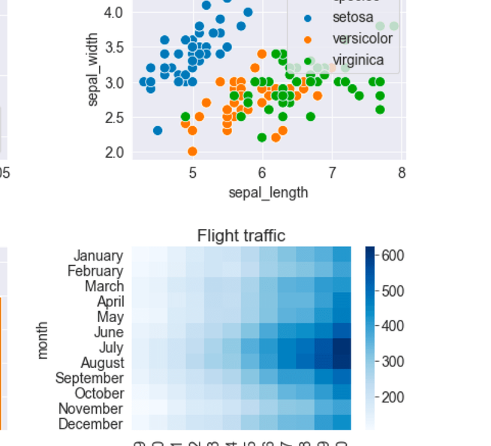

RESOURCES AND FURTHER READING
Python Data Analysis Library (Pandas)
Plotly, Matplotlib and Seaborn Visualization Libraries
National Oceanic and Atmospheric Administration (NOAA) Weather Data
Pandas is a powerful open-source library for data manipulation and analysis, ideal for working with weather data in Python.
These popular Python visualization libraries can be used to create informative and visually appealing plots and graphs to explore weather data.
NOAA is a reliable source of historical and real-time weather data that can be accessed and analyzed using Python.

Slide 5



DATA CLEANING AND PREPROCESSING
Missing Data Imputation
Outlier Detection and Removal
Encoding Categorical Features
Feature Scaling and Normalization

Slide 6

Objectives
To display information and descriptive statistics of the datasets.
To display the data types, number of unique values, and to filter out null values.
To identify unique wind speed values and calculate the number of unique wind speed values.
To calculate the average, maximum, and minimum wind speed.
To count the occurrences of specific wind speed values.
To identify instances when wind speed was above 20.
To display descriptive statistics and plot the distribution of wind gust data.
To calculate the mean value of each column (excluding 'date').
To display descriptive statistics and plot the distribution of precipitation data.
To convert the 'date' column to datetime format, extract the year, and calculate the maximum and minimum temperature for each year.
Visualize maximum and minimum temperatures of each year.
To identify the year with the maximum and minimum temperature.
To calculate and plot the rolling mean for average temperature.
Visualize temperature trends over time using line plots.
To create a box plot to show the monthly temperature distribution.
To plot the distribution of average temperature data using a histogram.
To visualize temperature clusters by month using scatter plots.
Display the frequency distribution of temperature readings using a histogram.
To plot the yearly mean temperature over time using line and marker plots.
To create a scatter plot to show seasonal mean temperatures throughout the years.
To animate scatter plots to show temperature changes over time.
To calculate mean temperatures for different seasons (Winter, Summer, Monsoon, Autumn).
To create a dataframe with seasonal data and visualize it using scatter plots with trendlines.
To develop a dashboard with features include dropdowns, graphs, and data tables using Dash to interactively display the analysis results.
To display summary statistics and additional analysis results on the dashboard.

Slide 7
“WEATHER DATA ANALYSIS WITH PYTHON CAN UNLOCK VALUABLE INSIGHTS AND SUPPORT INFORMED DECISION-MAKING ACROSS INDUSTRIES.”

